Slide 1
How to Read Technical Papers

Slide 2
Engineering Research Papers
Challenges for reading:
Written succinctly
Page limitation
Accepted style
Don’t write verbosely
For specific audience
Knows area well

Slide 3
Engineering Research Papers
Challenges for reading:
Time is limited:
Don’t read every word of every paper
Don’t read every paper several times (unless it is specifically very related to your research)
Don’t try to understand everything in the paper (unless you know it is very important)
General tip:
See what you want from this paper.

Slide 4
General Structure of a Paper
Despite different contents, very similar structure
→ Paper reading: a repetitive activity
By knowing the structure of papers, you may want to read a paper out of order

Slide 5
General Structure of a Paper
Abstract:
Abstract of the paper:
A brief intro
Problem statement
Authors’ contribution
Achievements

Slide 6
General Structure of a Paper
Introduction:
The entry statements to the subject
More clear “statement of the problem”
What is solved
Motivations
Why it is important
Literature review
Sometimes in a separate section
Contribution
How it is solved (one/two before last paragraphs)
Organization of the paper

Slide 7
General Structure of a Paper
Literature Review:
Related work
How they approached the same/related problem
What are the disadvantages
Body: should show that their paper doesn’t have these problems

Slide 8
General Structure of a Paper
Body:
Basic concepts
Terminology (definitions)
Assumptions
Their solution
Experimental Results:
The environment for experiments
Results
Analysis of results
Conclusion and Future works
Sample paper

Slide 9
General Structure of a Paper
Homework:
Select a paper in the field of Computer Architecture/Computer Networks
Annotate sections/paragraphs according to the general structure of papers
Deadline:
Next Tuesday (9 Aban)

Slide 10
Engineering Research Papers
Paper Reading Methodology:
During choosing area/topic:
Need to start from broad and end with specific gradually:
Beginning: read many papers fast
…
End: read few papers in depth
If found a key paper:
Refer backward and forward
Explore related papers
https://scholar.google.com

Slide 11
Engineering Research Papers
Paper Reading Methodology:
During choosing area/topic (if options not provided to you):
Browse recent conference proceedings/journals
Good ones? (Ask your advisor)
Journals vs. conferences (rigorous review, newer achievements)
Choose appropriate sessions
Read the paper titles and choose the papers of your interest
Old problems (not solved well): low priority
E.g. give a better solution to an old NP-complete problem

Slide 12
Engineering Research Papers
Paper Reading Methodology: 3-pass approach
Get general idea
Grasp the paper’s content
Not in details
Understand the paper in depth

Slide 13
Three-Pass Approach
Pass 1 (get general idea):
A quick scan to get the main idea
Can decide whether you need to do more passes
5-10 minutes

Slide 14
Three-Pass Approach
Pass 1 (get general idea):
Steps:
Carefully read the title, abstract, [parts of introduction]
Read (sub-)sections headings
Read conclusions
Glance over the references

Slide 15
Three-Pass Approach
Pass 1 (get general idea):
After pass 1: should be able to answer to:
Category:
What type of paper is this?
Analysis of an existing system?
An algorithm development paper?
…
Context:
Which other papers is it related to?
Which theoretical bases used?
[Correctness:
Assumptions valid?]
Main contributions?
Clarity?
Well written?

Slide 16
Three-Pass Approach
Pass 1 (get general idea):
Reasons for not reading further:
Doesn’t interest you
Authors make invalid assumptions
You don’t know enough about the area

Slide 17
Three-Pass Approach
Important note for writing paper:
Reviewer may make one pass over your paper
→
Choose the title best indicating the content
Write comprehensive abstract/intro/conclusion
If the reviewer cannot understand the main idea of your paper in 5 minutes → likely reject

Slide 18
Three-Pass Approach
Pass 2:
Grasp the paper’s content
~ 1 hour
Steps:
Read the whole paper but ignore details
E.g., proofs, the details of implementation/experiments.
Look carefully at the figures, diagrams, etc.
To get an idea of the proposed solution, etc.
Mark relevant references for further reading
Write a statement in front of it
Keep a list of references which you wish to get back to

Slide 19
Three-Pass Approach
Pass 2 (grasp the paper’s content):
After pass 2: should be able to:
Summarize the main point, with supporting evidence, to someone else
If you don’t understand it, possible reasons:
Subject matter is new to you, with unfamiliar terminology and acronyms
Authors may use techniques/matters that you don’t understand
Poorly written
You’re tired!

Slide 20
Three-Pass Approach
Then, possible options (based on your judgment):
Set the paper aside, hoping you don’t need to understand the material to be successful
Return to the paper later, perhaps after reading background material
Persevere and go on to the third pass

Slide 21
Three-Pass Approach
Pass 3 (understand the paper in depth):
~5 hours for beginners, ~1 hour for experienced reader
→After pass 3: should be able to:
identify and challenge every assumption in every statement (hidden failings and assumptions)
think about how you yourself would propose ideas for future work
virtually re-implement the paper
i.e., making the same assumptions as the authors, re-create the work

Slide 22
Important Questions to Be Answered by Reader

Slide 23
Questions to Be Looked for
Important point:
What do you want from the paper
Questions which you should look for answers to:
What are the motivations for this work?
Expectation: a problem solved that no one has solved before
Types of problems:
People’s problem (often not stated): benefits that are desired in the world (e.g., errors in mobile comm, slow computations)
Technical problem: why doesn’t people’s problem have a trivial solution
→ What are previous solutions
and why they are not adequate

Slide 24
Questions to Be Looked for
What is the proposed solution? (hypothesis or idea)
Why is it believed that it will work?
What are the supporting evidences of the idea?
Argument
Implementation
Experiments
Why is it believed that it is better than others?
What benefits are identified?
An idea alone is not adequate for publication
How is the solution achieved (or achievable)?

Slide 25
Questions to Be Looked for
What is your analysis of the identified problem?
Is it a good idea? (what are the flaws?)
What are the most interesting points made?
(In some practical areas) who would want it?
(In some theoretical areas) when might it become a reality?

Slide 26
Questions to Be Looked for
What are the future directions for this research?
Their insight
Your own ideas (take notes for future research)
Can it be generalized/specialized?
Can the flaws be overcome?
Can the assumptions be corrected and solve it again?
What is your take-away message from this paper?
Sum up the main implication of the paper from your own perspective
Very useful for quick review and refreshing your memory
Forces you to try to identify the essence of the work
What questions are you left with?
What questions would you like to raise in an open discussion of the work
What do you find difficult to understand?

Slide 27
Note Taking Practice

Slide 28
Note Taking
Note taking:
Highlight important comment:
Use a highlighter combined with underlining.
Should really help key sentences/words "pop out" at you when you return to review the paper later.

Slide 29
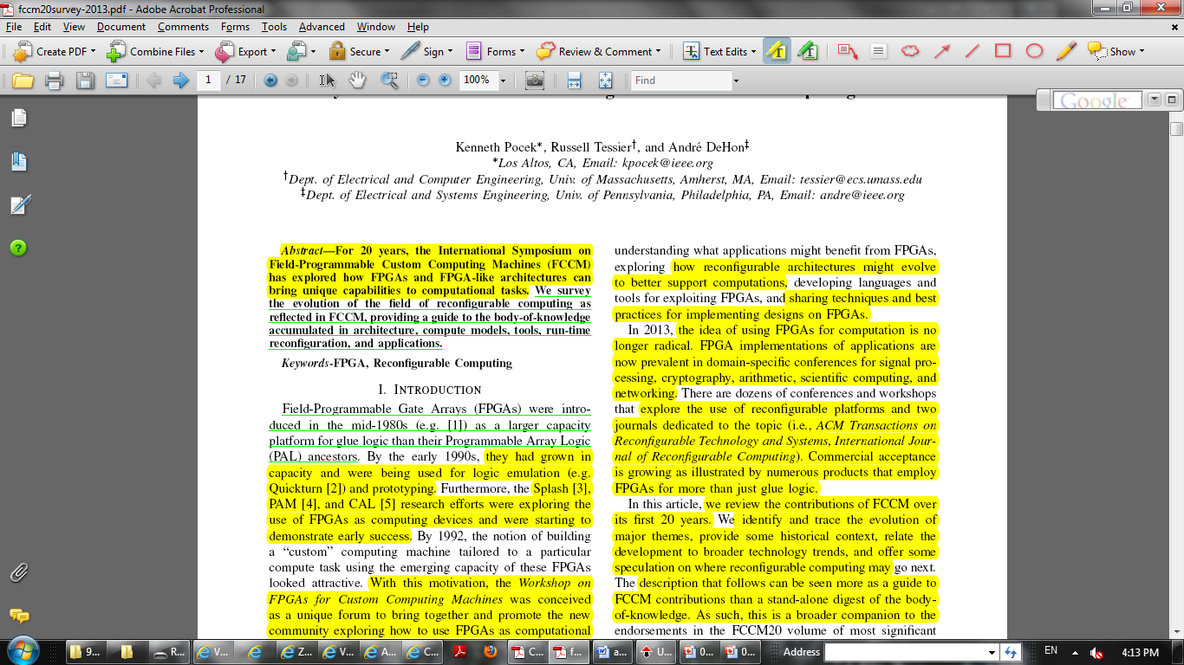

Slide 30
Note Taking
Note taking:
Mark the important paragraphs according to
motivation/problem
idea/solution
their evaluation
contributions
On the front of the paper, write down the take-away message

Slide 31
Note Taking
Note taking:
On the front of the paper, or near the end, write down your key questions.
Other questions may be written in the margins as you read.
Try to answer the questions for yourself, as best you can.
Use other sources as appropriate
Wikipedia
Google
Text books
...

Slide 32
Paper Reading
Criticizing the paper:
Should first complete the above process
Another pass over the paper may be needed

Slide 33
Notes
Components of notes:
Take-away message (your own)
Category (analysis, algorithm, circuit, …)
Problem
People’s vs. technical problem
Solution
Use the words which will remind you instantly
Main differences with other papers
Inspired ideas
Critical views
Key questions
Future directions
Classification of papers

Slide 34
Literature Survey

Slide 35
Literature Survey
What is literature survey for a paper/thesis?
“Use of ideas in the literature to justify
the particular approach to the topic,
the selection of methods, and
demonstration that this research contributes something new.” [Hart98]
Novice researchers’ view:
A collection of summaries of related papers!

Slide 36
Literature Survey
“Authors of literature review are at risk for producing mind-numbing lists of citations and findings that resemble a phone book – impressive case, lots of numbers, but not much plot” [Bem95].
Researchers must continuously ask themselves:
How is the work presented in the article related to my study?
→ allows them to tie the literature into their own study

Slide 37
Literature Survey Paper
Stand-alone literature survey:
Introduces the area
Basic concepts
Definition of problem (related problems)
People’s problems and technical problems
Solutions and classification
Their relationship
Critical analysis:
Advantages/disadvantages

Slide 38
Literature Survey
Stand-alone literature survey:
Should explain how one piece of research builds on another [Shaw95]
“If I have seen further, it is by standing on ye shoulders of Giants.” Isaac Newton
Creates a firm foundation for advancing knowledge
Facilitates theory development
[Closes areas where a plethora of research exists]
Uncovers areas where research is needed [Webster02]
A sample paper in fileserver [Tehranipour10]:

Slide 39
References
W. Griswold, “How to Read an Engineering Research Paper,” cseweb.ucsd.edu/~wgg/CSE210/howtoread.html
S. Keshav, “How to Read a Paper,” ACM SIGCOMM Computer Communication Review, Volume 37, Number 3, July 2007.
Y. Levy and T. Ellis, “A Systems Approach to Conduct an Effective Literature Review in Support of Information Systems Research”, Informing Science Journal, Volume 9, 2006.
M. Tehranipour and F. Koushanfar, “A Survey of Hardware Trojan Taxonomy and Detection,” IEEE Design & Test of Computers, 2010.

